Slide 1

Peoples Information Technology Program (PITP)—Week 01, Day 02
Introduction to Python & Programming Concepts
Atta Muhammad
attapanhyar@quest.edu.pk
+923331971110
Quaid e Awam University of Engineering, Science and Technology

Slide 2
Contents
Learning Objectives
Variables
Data Types
Casting
Arithmetic Operators

Slide 3
Learning Objectives
Understand how variables work.
Perform arithmetic operations in Python.
Use Python for real-world calculations.
Explore different data types and operations.

Slide 4
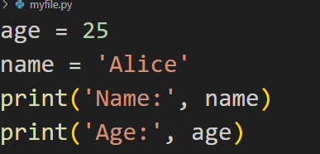
Variable
What are variables? Variables store data values.

Slide 5

Data Types in Python
Common Data Types:
Integers: Whole numbers (e.g., 5, 10)
Floats: Decimal numbers (e.g., 3.14, 10.5)
Strings: Text (e.g., "Hello, World!")
Booleans: True/False values (e.g., True, False)

Slide 6
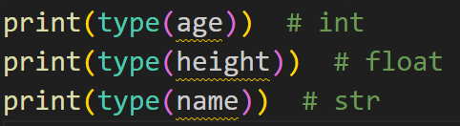
Checking Data Types
Use type() function:

Slide 7
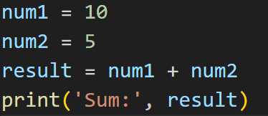
Arithmetic Operations in Python
Basic Operations:
Addition (+)
Subtraction (-)
Multiplication (*)
Division (/)

Slide 8
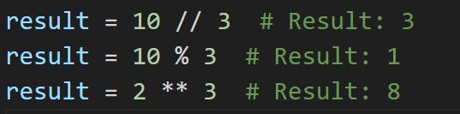
Advanced Arithmetic Operations

Slide 9
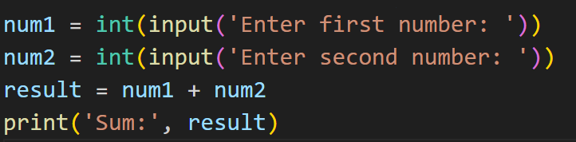
User Input and Calculations
Getting input from the user:
Input as different data types (e.g., int(), float()).

Slide 10
Exercise 1
Task: Write a program that asks the user for two numbers, then calculates and displays:
The sum
The difference
The product
The quotient

Slide 11
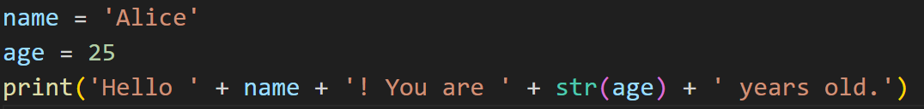
Combining Strings and Numbers
String Concatenation with Numbers:
Using f-strings (recommended):

Slide 12
Exercise 2
Task: Write a program that asks for the user’s name and age, then calculates how many years are left until they turn 100 and prints a message.

Slide 13
Data Type Conversion
Converting between types:
Convert to integer: int()
Convert to float: float()
Convert to string: str()

Slide 14
Exercise 3
Task: Write a program that takes two inputs, converts them to floats, and calculates the area of a rectangle.

Slide 15
Recap and Q&A
Summary: We covered variables, data types, arithmetic operations, and user input.
Any questions?

